Slide 1
The Effects of van Hove Singularities on Intrinsically Localized Vibrations
Benjamin Agyare, Stockton University &
Peter Riseborough (PhD), Temple University

Slide 2
The Effects of van Hove Singularities on Intrinsically Localized Vibrations
ILMs are persistent vibrations of atoms in a homogeneous lattice which extend only over a finite region of space.
It’s been reported that these vibrations can be found in NaI, but only exist for wave-vectors at the corner of the 3-D Brillouin Zone.
It has been suggested that ILMs occur whenever the van-Hove singularities of the two phonon density of states coalesce at the upper-edge of the continuum.

Slide 3
The Effects of van Hove Singularities on Intrinsically Localized Vibrations
Objectives:
To investigate the one-phonon & two-phonon density of states of NaI and examine its van-Hove singularities in order to identify at which q vectors they may coalesce.
To introduce anharmonic interactions and determine if they are enhanced by the van-Hove leading to the formation of ILMS.

Slide 4
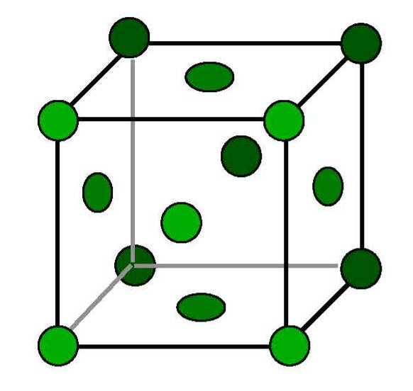
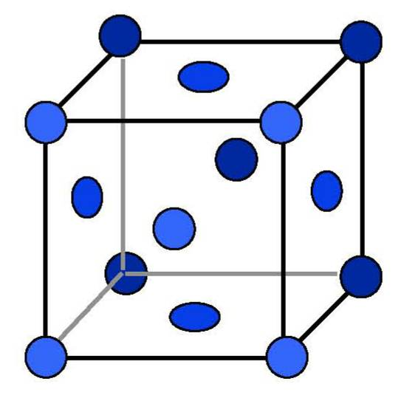
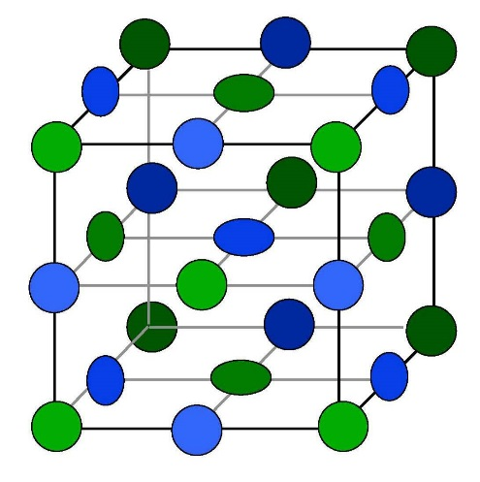

The Effects of van Hove Singularities on Intrinsically Localized Vibrations
Modeled by coupling the atoms located at the lattice sites equivalent to (0,0,0) for I atoms (mass M_{A} = 127) to the Na atoms (of mass M_{B} =23) located at the nearest-neighbor sites $\frac{a}{2}\left(1,1,1\right)$ by isotropic harmonic forces.
Lattice parameter ‘a’ is equal to 6.47 Angstroms.
 | + |  | =
I
Na

Slide 5
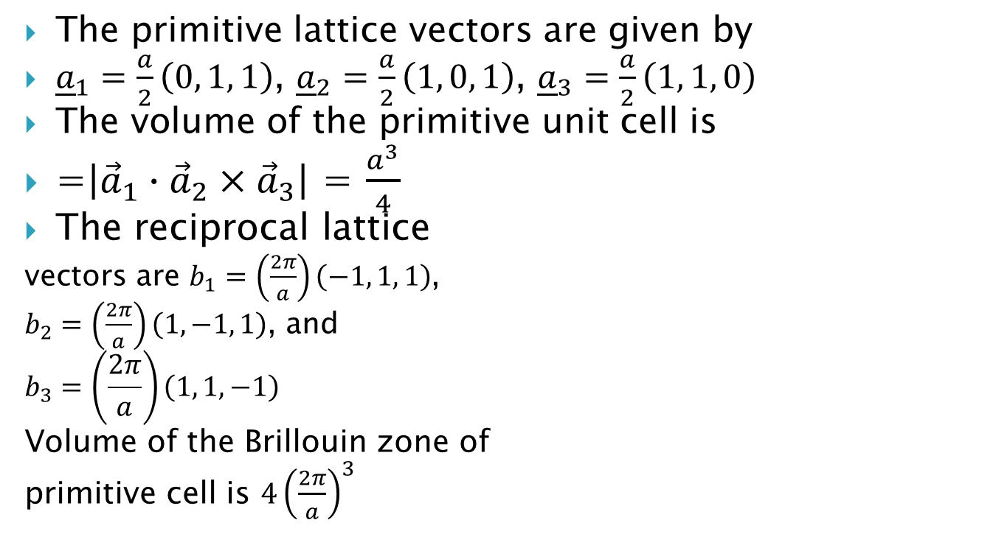


The Effects of van Hove Singularities on Intrinsically Localized Vibrations
The primitive lattice vectors are given by
${\underline{a}}_{1}=\frac{a}{2}\left(0, 1, 1\right)$, ${\underline{a}}_{2}=\frac{a}{2}\left(1, 0, 1\right)$, ${\underline{a}}_{3}=\frac{a}{2}\left(1, 1, 0\right)$
The volume of the primitive unit cell is
=$\left|{\vec{a}}_{1}∙{\vec{a}}_{2}×{\vec{a}}_{3}\right|$ = $\frac{a^{3}}{4}$
The reciprocal lattice
vectors are $b_{1}=\left(\frac{2π}{a}\right)\left(−1, 1, 1\right)$,
$b_{2}=\left(\frac{2π}{a}\right)\left(1, −1, 1\right)$, and
$$b_{3}=\left(\frac{2π}{a}\right)\left(1, 1, −1\right)$$
Volume of the Brillouin zone of
primitive cell is $4{\left(\frac{2π}{a}\right)}^{3}$
z
$$a_{1}$$
$$a_{2}$$
y
a₃
x
Notes:
Step 4. Lattice dynamics is modeled by coupling the atoms located at the lattice sites.
Note; A primitive cell is a unit cell built on the primitive basis of the direct lattice

Slide 6
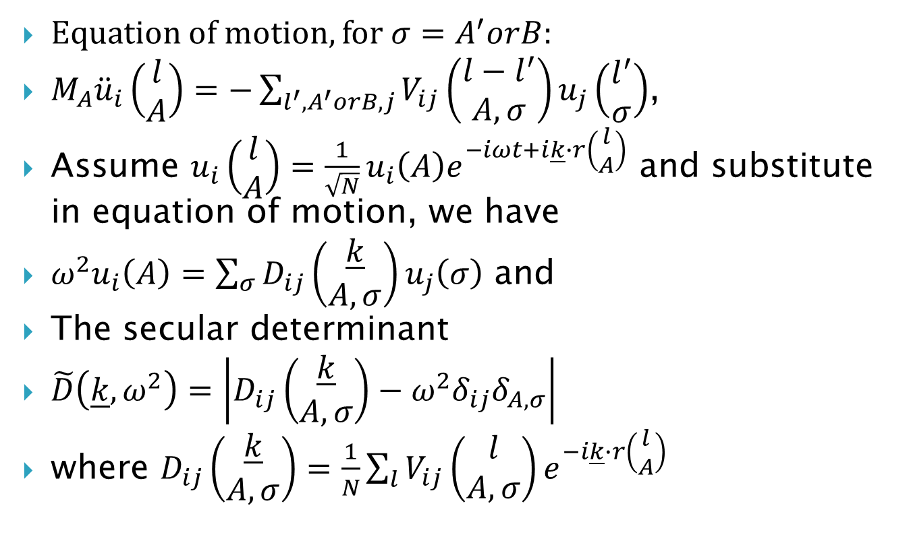
The Effects of van Hove Singularities on Intrinsically Localized Vibrations
Equation of motion, for ${σ=A}^{′}orB$:
$M_{A}{\ddot{u}}_{i}\left(\begin{matrix}l \\ A\end{matrix}\right)=−\sum_{l^{′},A^{′}orB,j}{V_{ij}\left(\begin{matrix}l−l^{′} \\ A,σ\end{matrix}\right)u_{j}\left(\begin{matrix}l^{′} \\ σ\end{matrix}\right)}$,
Assume $u_{i}\left(\begin{matrix}l \\ A\end{matrix}\right)=\frac{1}{\sqrt{N}}u_{i}\left(A\right)e^{−iωt+i\underline{k}∙r\left(\begin{matrix}l \\ A\end{matrix}\right)}$ and substitute in equation of motion, we have
$ω^{2}u_{i}\left(A\right)=\sum_{σ}{D_{ij}\left(\begin{matrix}\underline{k} \\ A,σ\end{matrix}\right)}u_{j}\left(σ\right)$ and
The secular determinant
$\tilde{D}\left(\underline{k},ω^{2}\right)=\left|D_{ij}\left(\begin{matrix}\underline{k} \\ A,σ\end{matrix}\right)−ω^{2}δ_{ij}δ_{A,σ}\right|$
where $D_{ij}\left(\begin{matrix}\underline{k} \\ A,σ\end{matrix}\right)=\frac{1}{N}\sum_{l}{V_{ij}\left(\begin{matrix}l \\ A,σ\end{matrix}\right)e^{−i\underline{k}∙r\left(\begin{matrix}l \\ A\end{matrix}\right)}}$

Slide 7
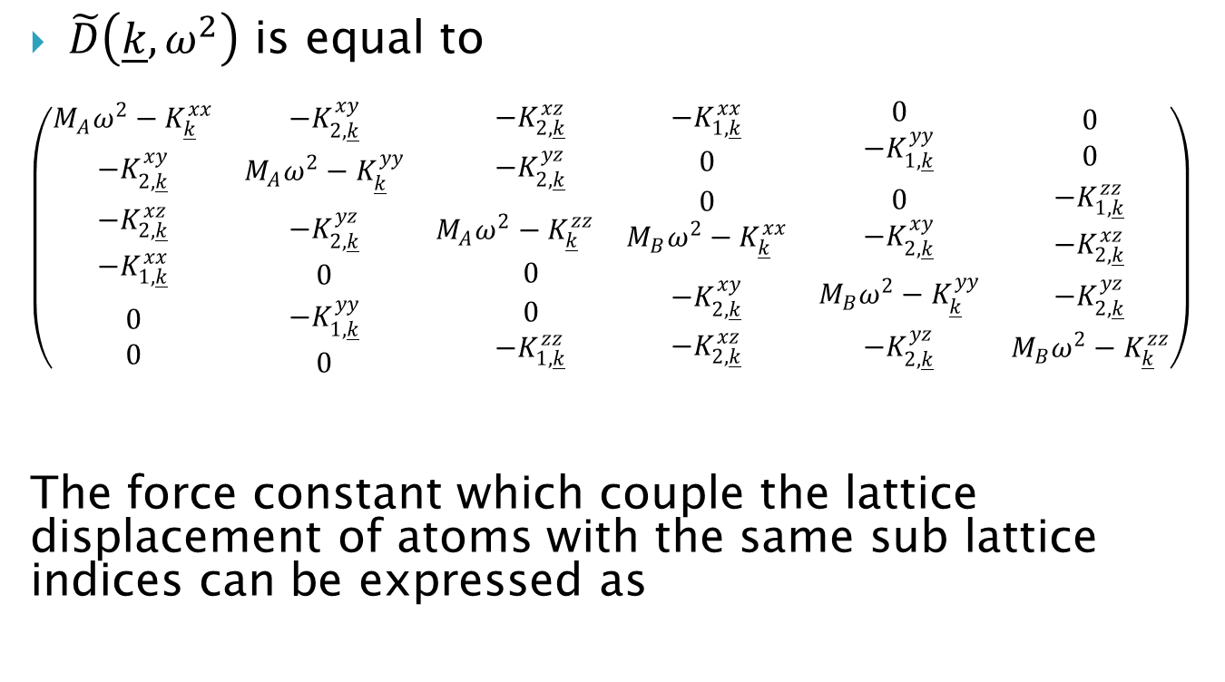
The Effects of van Hove Singularities on Intrinsically Localized Vibrations
$\tilde{D}\left(\underline{k},ω^{2}\right)$ is equal to
$$\left(\begin{matrix}\begin{matrix}M_{A}ω^{2}−K_{\underline{k}}^{xx} \\ −K_{2,\underline{k}}^{xy}\end{matrix} & \begin{matrix}−K_{2,\underline{k}}^{xy} \\ M_{A}ω^{2}−K_{\underline{k}}^{yy}\end{matrix} & \begin{matrix}−K_{2,\underline{k}}^{xz} \\ −K_{2,\underline{k}}^{yz}\end{matrix} \\ \begin{matrix}−K_{2,\underline{k}}^{xz} \\ −K_{1,\underline{k}}^{xx}\end{matrix} & \begin{matrix}−K_{2,\underline{k}}^{yz} \\ 0\end{matrix} & \begin{matrix}M_{A}ω^{2}−K_{\underline{k}}^{zz} \\ 0\end{matrix} \\ \begin{matrix}0 \\ 0\end{matrix} & \begin{matrix}−K_{1,\underline{k}}^{yy} \\ 0\end{matrix} & \begin{matrix}0 \\ −K_{1,\underline{k}}^{zz}\end{matrix}\end{matrix}\begin{matrix}\begin{matrix}−K_{1,\underline{k}}^{xx} \\ 0\end{matrix} & \begin{matrix}0 \\ −K_{1,\underline{k}}^{yy}\end{matrix} & \begin{matrix}0 \\ 0\end{matrix} \\ \begin{matrix}0 \\ M_{B}ω^{2}−K_{\underline{k}}^{xx}\end{matrix} & \begin{matrix}0 \\ −K_{2,\underline{k}}^{xy}\end{matrix} & \begin{matrix}−K_{1,\underline{k}}^{zz} \\ −K_{2,\underline{k}}^{xz}\end{matrix} \\ \begin{matrix}−K_{2,\underline{k}}^{xy} \\ −K_{2,\underline{k}}^{xz}\end{matrix} & \begin{matrix}M_{B}ω^{2}−K_{\underline{k}}^{yy} \\ −K_{2,\underline{k}}^{yz}\end{matrix} & \begin{matrix}−K_{2,\underline{k}}^{yz} \\ M_{B}ω^{2}−K_{\underline{k}}^{zz}\end{matrix}\end{matrix}\right)$$
The force constant which couple the lattice displacement of atoms with the same sub lattice indices can be expressed as

Slide 8
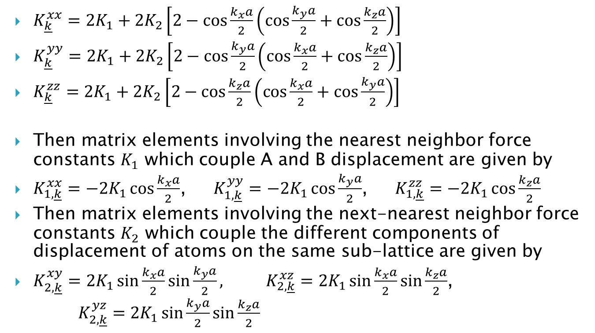
The Effects of van Hove Singularities on Intrinsically Localized Vibrations
$K_{\underline{k}}^{xx}=2K_{1}+2K_{2}\left[2−\cos{\frac{k_{x}a}{2}\left(\cos{\frac{k_{y}a}{2}}+\cos{\frac{k_{z}a}{2}}\right)}\right]$
$K_{\underline{k}}^{yy}=2K_{1}+2K_{2}\left[2−\cos{\frac{k_{y}a}{2}\left(\cos{\frac{k_{x}a}{2}}+\cos{\frac{k_{z}a}{2}}\right)}\right]$
$K_{\underline{k}}^{zz}=2K_{1}+2K_{2}\left[2−\cos{\frac{k_{z}a}{2}\left(\cos{\frac{k_{x}a}{2}}+\cos{\frac{k_{y}a}{2}}\right)}\right]$
Then matrix elements involving the nearest neighbor force constants $K_{1}$ which couple A and B displacement are given by
$K_{1,\underline{k}}^{xx}=−2K_{1}\cos{\frac{k_{x}a}{2}}$, $K_{1,\underline{k}}^{yy}=−2K_{1}\cos{\frac{k_{y}a}{2}}$, $K_{1,\underline{k}}^{zz}=−2K_{1}\cos{\frac{k_{z}a}{2}}$
Then matrix elements involving the next-nearest neighbor force constants $K_{2}$ which couple the different components of displacement of atoms on the same sub-lattice are given by
$K_{2,\underline{k}}^{xy}=2K_{1}\sin{\frac{k_{x}a}{2}}\sin{\frac{k_{y}a}{2}}, K_{2,\underline{k}}^{xz}=2K_{1}\sin{\frac{k_{x}a}{2}}\sin{\frac{k_{z}a}{2}}$,
$K_{2,\underline{k}}^{yz}=2K_{1}\sin{\frac{k_{y}a}{2}}\sin{\frac{k_{z}a}{2}}$

Slide 9
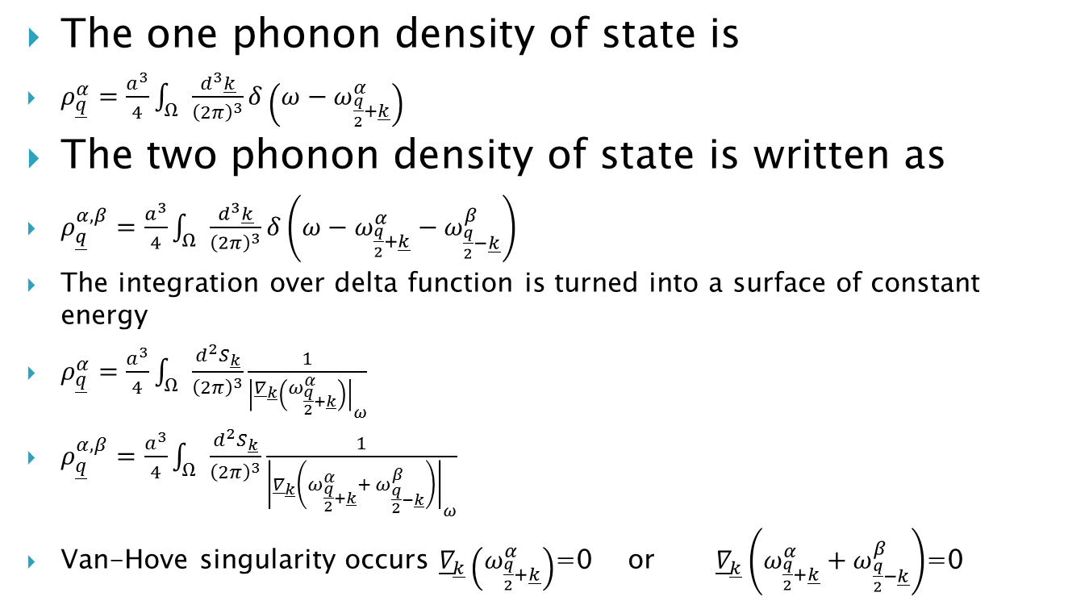
The Effects of van Hove Singularities on Intrinsically Localized Vibrations
The one phonon density of state is
$ρ_{\underline{q}}^{α}=\frac{a^{3}}{4}\int_{Ω}{\frac{d^{3}\underline{k}}{{\left(2π\right)}^{3}}}δ\left(ω−ω_{\frac{q}{2}+\underline{k}}^{α}\right)$
The two phonon density of state is written as
$ρ_{\underline{q}}^{α,β}=\frac{a^{3}}{4}\int_{Ω}{\frac{d^{3}\underline{k}}{{\left(2π\right)}^{3}}}δ\left(ω−ω_{\frac{q}{2}+\underline{k}}^{α}−ω_{\frac{q}{2}−\underline{k}}^{β}\right)$
The integration over delta function is turned into a surface of constant energy
$ρ_{\underline{q}}^{α}=\frac{a^{3}}{4}\int_{Ω}{\frac{d^{2}S_{\underline{k}}}{{\left(2π\right)}^{3}}}\frac{1}{{\left|{\underline{∇}}_{\underline{k}}\left(ω_{\frac{q}{2}+\underline{k}}^{α}\right)\right|}_{ω}}$
$ρ_{\underline{q}}^{α,β}=\frac{a^{3}}{4}\int_{Ω}{\frac{d^{2}S_{\underline{k}}}{{\left(2π\right)}^{3}}}\frac{1}{{\left|{\underline{∇}}_{\underline{k}}\left(ω_{\frac{q}{2}+\underline{k}}^{α}+ ω_{\frac{q}{2}−\underline{k}}^{β}\right)\right|}_{ω}}$
Van-Hove singularity occurs ${\underline{∇}}_{\underline{k}}\left(ω_{\frac{q}{2}+\underline{k}}^{α}\right)$=0 or ${\underline{∇}}_{\underline{k}}\left(ω_{\frac{q}{2}+\underline{k}}^{α}+ω_{\frac{q}{2}−\underline{k}}^{β}\right)$=0

Slide 10
The Effects of van Hove Singularities on Intrinsically Localized Vibrations

Slide 11
The Effects of van Hove Singularities on Intrinsically Localized Vibrations

Slide 12
The Effects of van Hove Singularities on Intrinsically Localized Vibrations

Slide 13
The Effects of van Hove Singularities on Intrinsically Localized Vibrations

Slide 14
The Effects of van Hove Singularities on Intrinsically Localized Vibrations
Summary:
The one-phonon and two-phonon density of states exhibits features at the van Hove singularities at fixed frequencies, but the spectral features are not divergent due to the 3-D nature of the crystal.
For different q values, several van Hove singularities converge at one frequency and produce a large peak in the two-phonon DOS.
Next: search for q values at which the two-phonon density of states is enhanced and then examine whether the introduction of anharmonic interactions can bind the two-phonon excitations to produce a quantized ILM.

Slide 15
References
[1]. A. J. Sievers, S. Takeno, Phys. Rev. Lett.
61, 970 (1988).
[2] W.Z. Wang, J.T. Gammel, A.R. Bishop and M.I. Salkola, Phys. Rev. Lett. 76, 3598-3601 (1996)
[3] L. Proville, Phys. Rev. B, 71, 104306 (2005).
[4] ME Manley AJ Sievers & JW Lynn, Phy. Rev B 79 134304 (2009)
[5] D. Kanbur & P.S. Riseborough, Phil. Mag. Letts 94, 424 – 432 (2014)

Slide 16
THANK YOU

